Slide 1
Second Project Review Modeling of Electromagnetic Stirring of Liquid Metals
Yash Ganatra (10BME1043)
Internal Guide: Dr. Jayasankar Variyar
External Guide: Dr. Pramod Kumar

Slide 2
Principle
The principle of working is similar to that of a linear induction motor. Electrically it is a two pole motor.
Circular Coils → Stator winding , Liquid Metal → Rotor
The coils are displaced in space by 120º. 3 phase currents
produce travelling magnetic field along axis of coil.
This varying field induces voltage in the molten metal in the tangential direction. The induced voltage establishes tangential eddy currents in the liquid metal.
The eddy current(tangential) in the liquid metal and the magnetic field(radial and axial) produce forces(axial and radial) in the liquid metal. These forces set the liquid metal into motion.

Slide 3
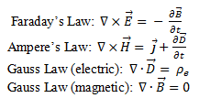
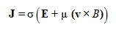
EM stirring- How it works ??
Solenoid coil
E is the electric field V/m
B is the magnetic flux density Wb/m²
H is the magnetic field intensity A/m
J is the current density A/m²
μ is the permeability of the metal H/m
σ is the conductivity
v is velocity of the fluid A/m
H(z,r)
L
J_{p}(A/m)
z
r
Field space
R
Metals -electrically conducting
Induced currents, magnetic fields ⇒ Lorentz Force
Applications
grain refinement.
Mix immiscible liquids
reduce hot tear (steels) due to large temperature. gradients in the melt etc.
Solenoid excited by an alternating current
Advantages
Non intrusive i No contamination.
Current and frequency i Control of stirring intensity, process.
Orientation and direction of primary current
Key parameters in generating the forces in desired direction.
Notes:
A sinusoidal distribution of mmf along the axis of the coils is achieved when the coils are displaced in space by 120. When these space displaced coils are excited by three phase currents, the resulting mmf is sinusoidally distributed in space as well as time.

Slide 4
Linear Stirrer – Design Problem
ELECTROMAGNETIC FIELDS
geometry, material, excitation current, frequency
INDUCED EDDY CURRENTS
MECHANICAL FORCES

Slide 5
Work Done after Review 1
Field formulation of Maxwell’s Equations
Casting of equations obtained into form required by FLUENT commerical solver
Implementing user defined scalar transport equations to solve in FLUENT
Validating the code written with test cases

Slide 6
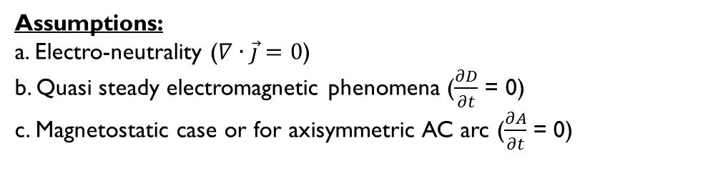
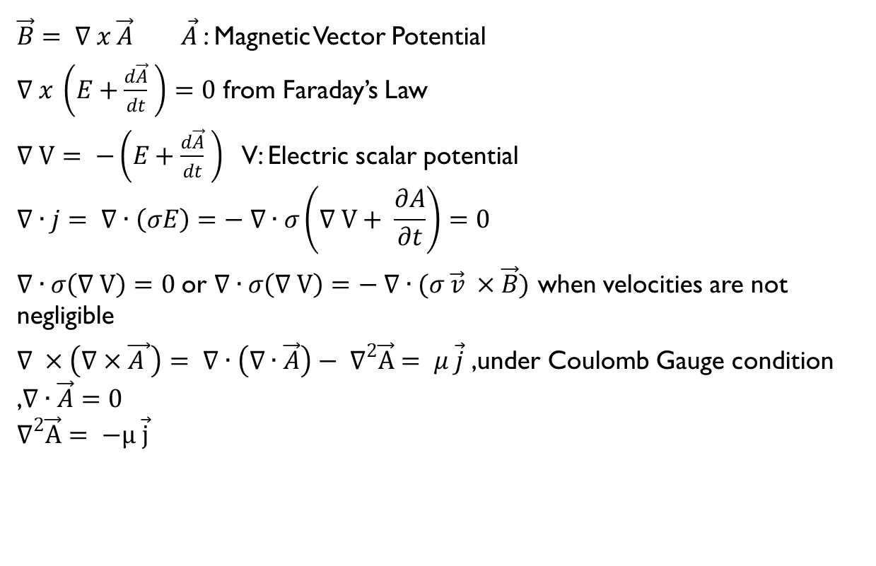
Potential Formulation (A-V)
$\vec{B}= ∇ x \vec{A} \vec{A}$: Magnetic Vector Potential
$∇ x \left(E+\frac{d\vec{A}}{dt} \right)=0$ from Faraday’s Law
$∇ V= −\left(E+\frac{d\vec{A}}{dt} \right)$ V: Electric scalar potential
$$∇∙j= ∇∙\left(σE\right)=− ∇∙σ\left(∇ V+ \frac{∂A}{∂t}\right)=0$$
$∇∙σ\left(∇ V\right)=0$or $∇∙σ\left(∇ V\right)=− ∇∙(σ \vec{v} ×\vec{B})$ when velocities are not negligible
$∇ ×\left(∇×\vec{A }\right)= ∇∙\left(∇∙\vec{A}\right)− ∇^{2}\vec{A}= μ \vec{j}$ ,under Coulomb Gauge condition ,$∇∙\vec{A}=0$
$$∇^{2}\vec{A}= −μ \vec{j}$$
Assumptions:
a. Electro-neutrality ($∇∙\vec{j}=0$)
b. Quasi steady electromagnetic phenomena ($\frac{∂D}{∂t}$ = 0)
c. Magnetostatic case or for axisymmetric AC arc ($\frac{∂A}{∂t}$ = 0)

Slide 7
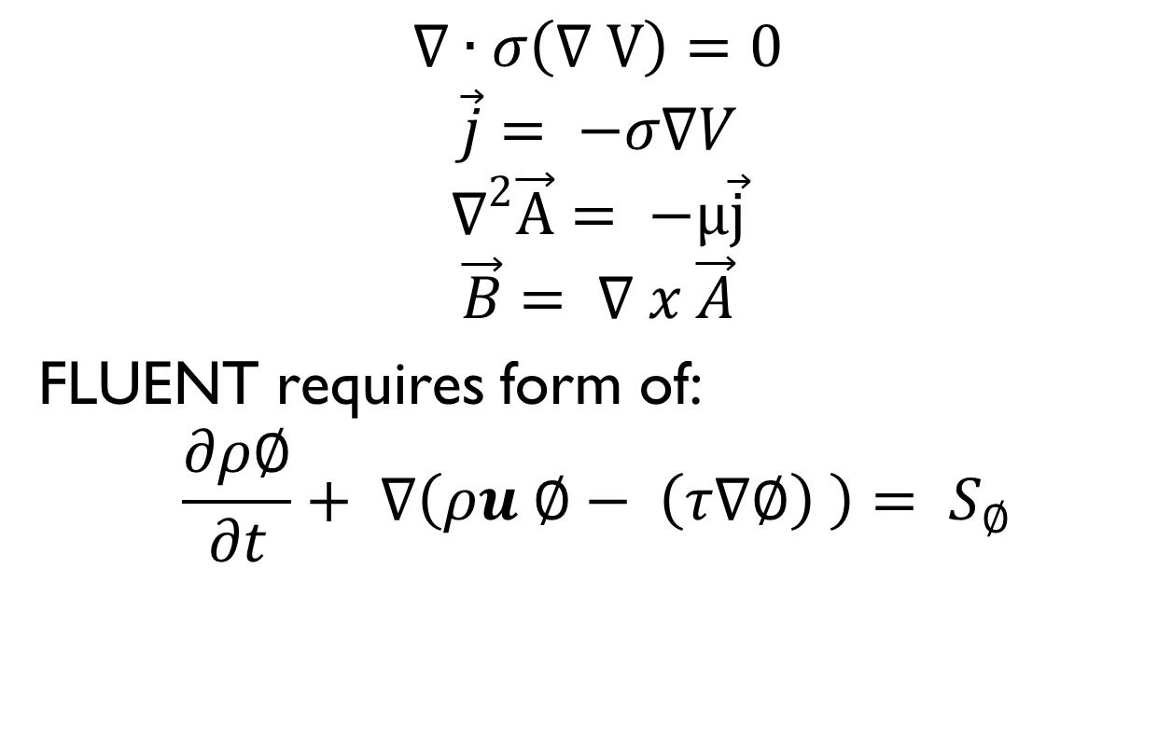
Simplified Equation Set
$$∇∙σ\left(∇ V\right)=0$$
$$\vec{j}= −σ∇V$$
$$∇^{2}\vec{A}= −μ\vec{j}$$
$$\vec{B}= ∇ x \vec{A}$$
FLUENT requires form of:
$$\frac{∂ρ∅}{∂t}+ ∇\left(ρu ∅− \left(τ∇∅\right) \right)= S_{∅}$$
Unsteady Term
Flux Term
Diffusion Term
SourceTerm

Slide 8
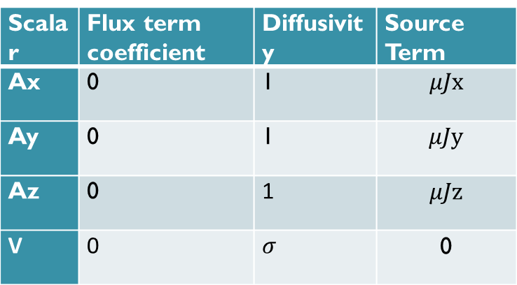
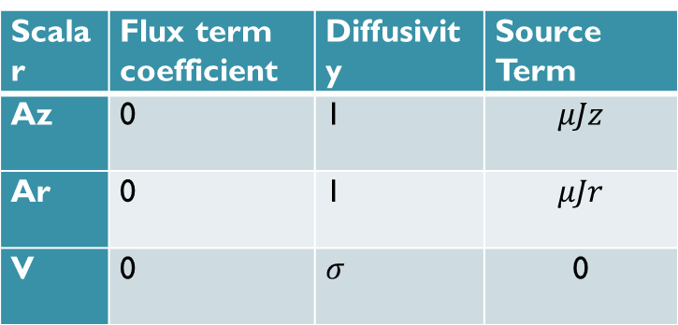
Casting into UDS
Scalar | Flux term coefficient | Diffusivity | Source Term
Az | 0 | 1 | $$μJz$$
Ar | 0 | 1 | $$μJr$$
V | 0 | $$σ$$ | 0
In Axi-symmetric Coordinates
Scalar | Flux term coefficient | Diffusivity | Source Term
Ax | 0 | 1 | $$μJx$$
Ay | 0 | 1 | $$μJy$$
Az | 0 | 1 | $$μJz$$
V | 0 | $$σ$$ | 0
In Cartesian Coordinates

Slide 9
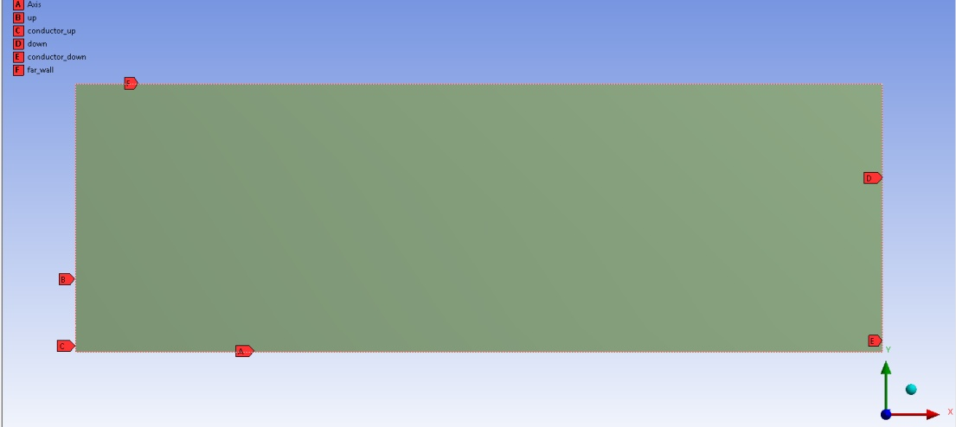
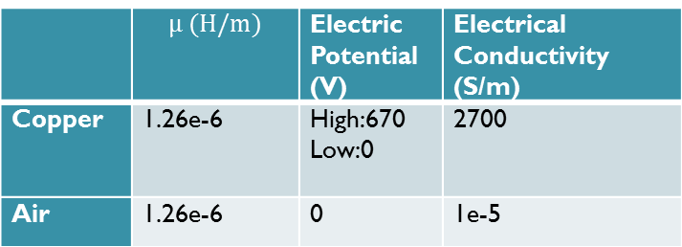
Validation 1 – Magnetic field around cylindrical current carrying conductor
Named Selections
Geometry from 3D to 2D axisymmetric
Boundary Conditions
 | A(V.s/m) | V (V)
Conductor_up | Zero normal gradient | 670
Conductor_down | Zero normal gradient | 0
Up | Zero normal gradient | Zero normal gradient
Down | Zero normal gradient | Zero normal gradient
Far_walls | Zero value | Zero normal gradient
Axis | Axis | Axis
 | $$μ (H/m)$$ | Electric Potential (V) | Electrical Conductivity (S/m)
Copper | 1.26e-6 | High:670 Low:0 | 2700
Air | 1.26e-6 | 0 | 1e-5
Material Properties

Slide 10
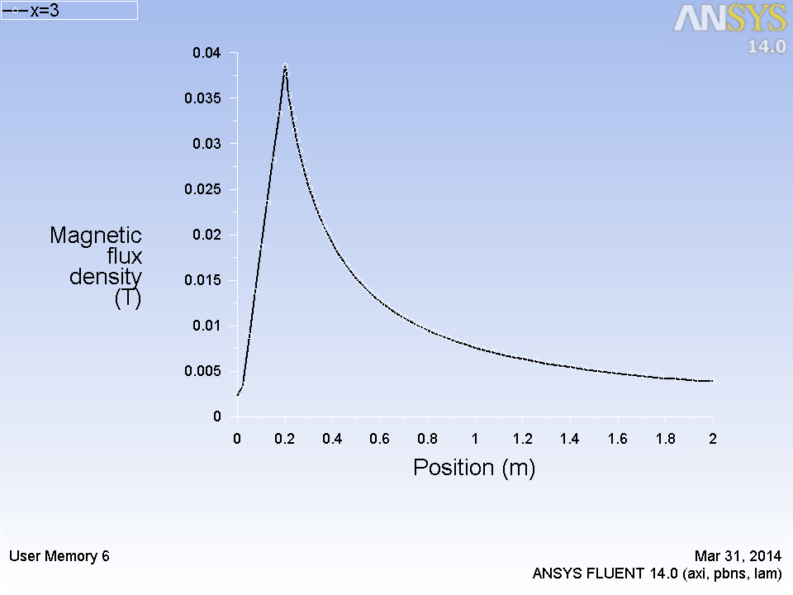
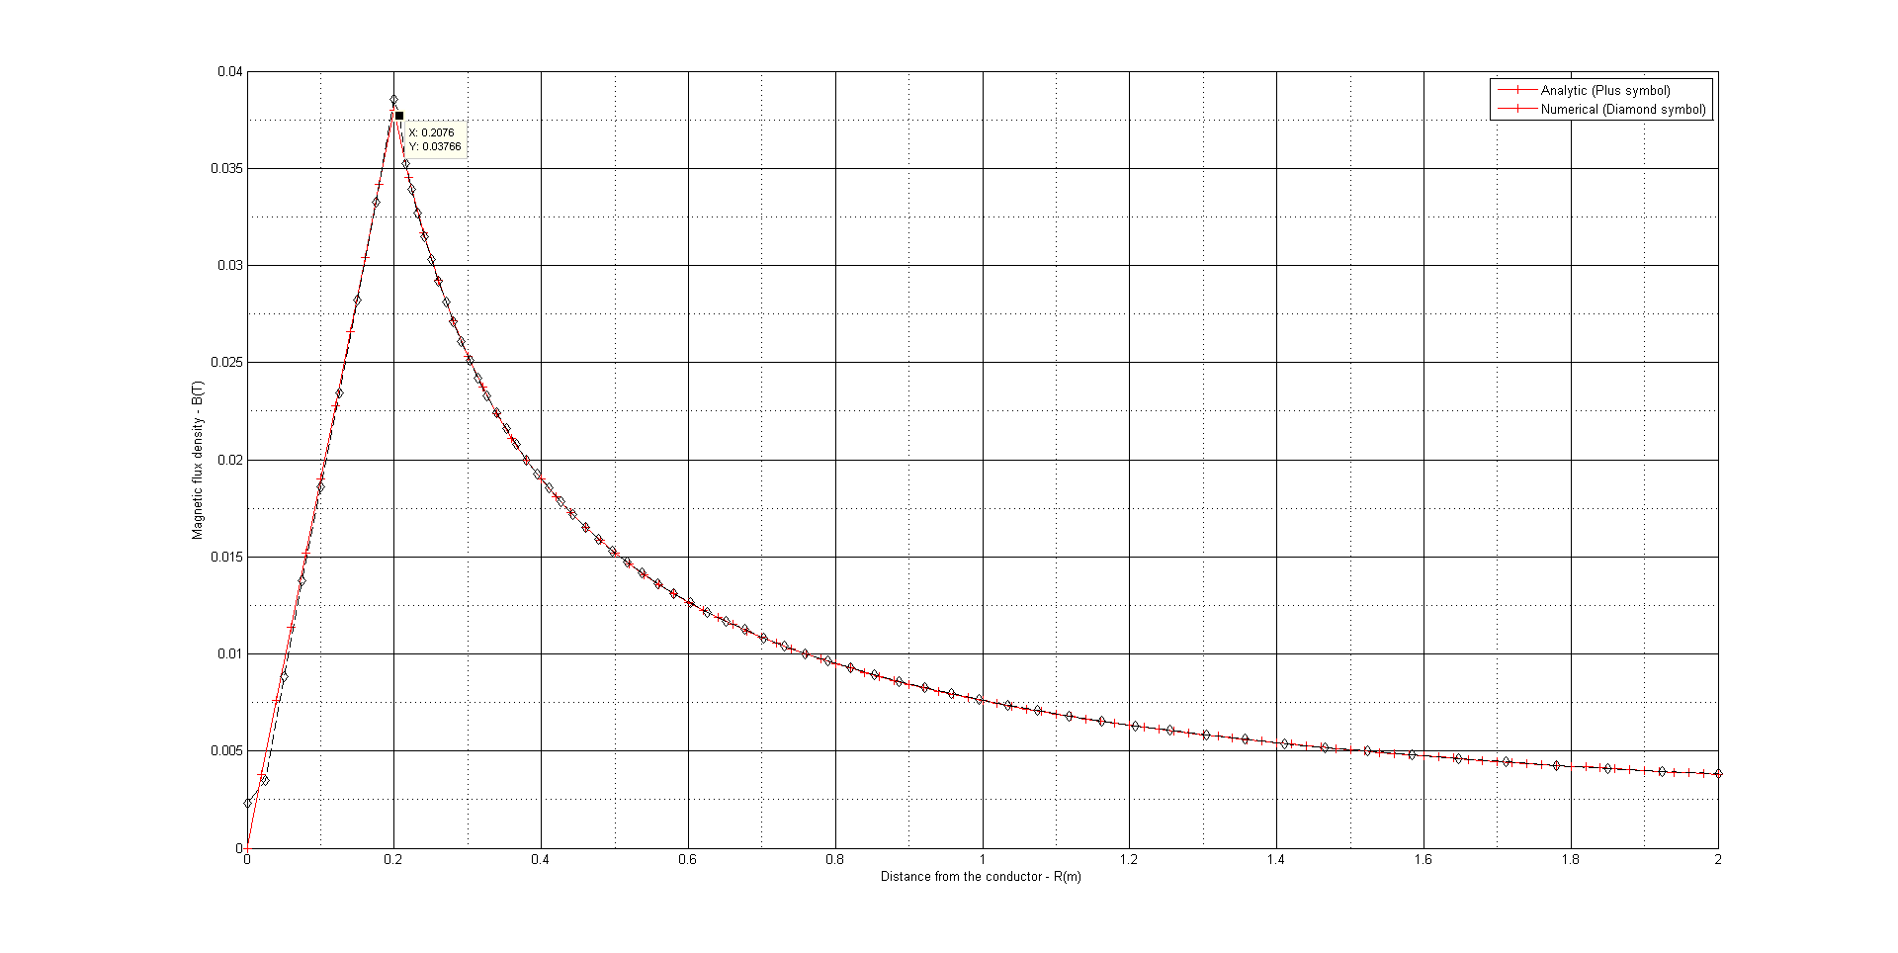
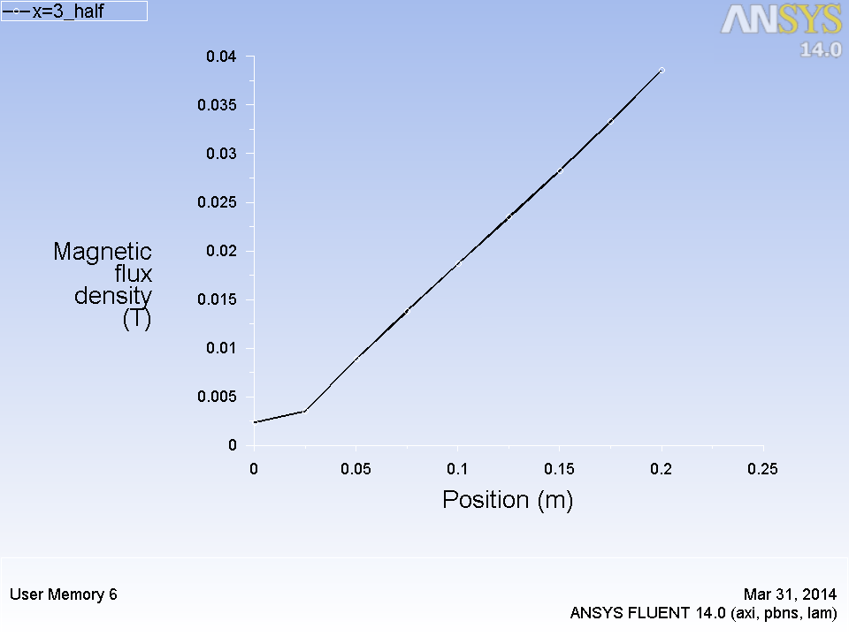
Results
(a)
(b)
(a): Line plot of magnetic field from FLUENT
(b): Comparison of line plots obtained from FLUENT and the analytical solution obtained in MATLAB
(c): Magnetic field inside the conductor
(c)

Slide 11
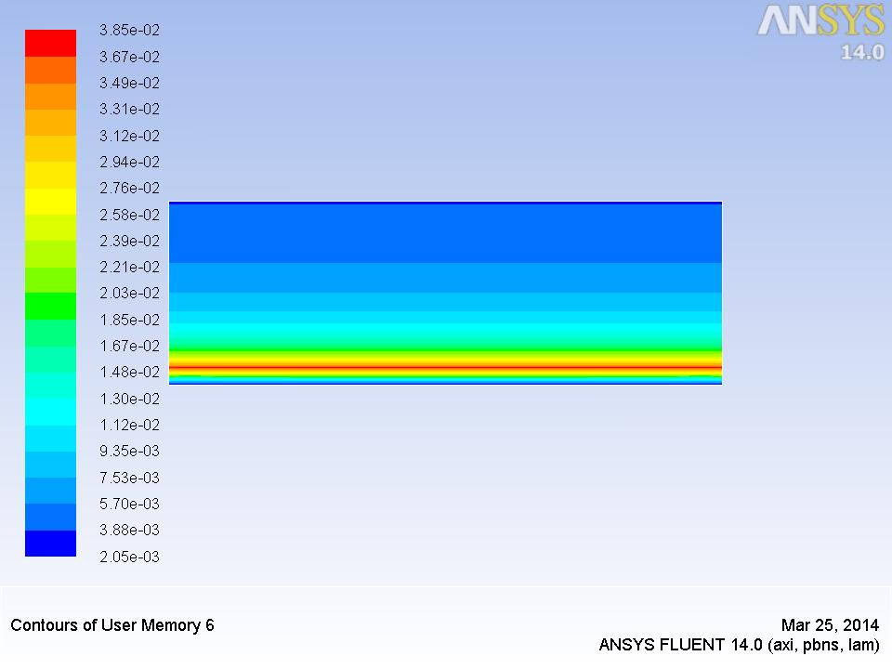
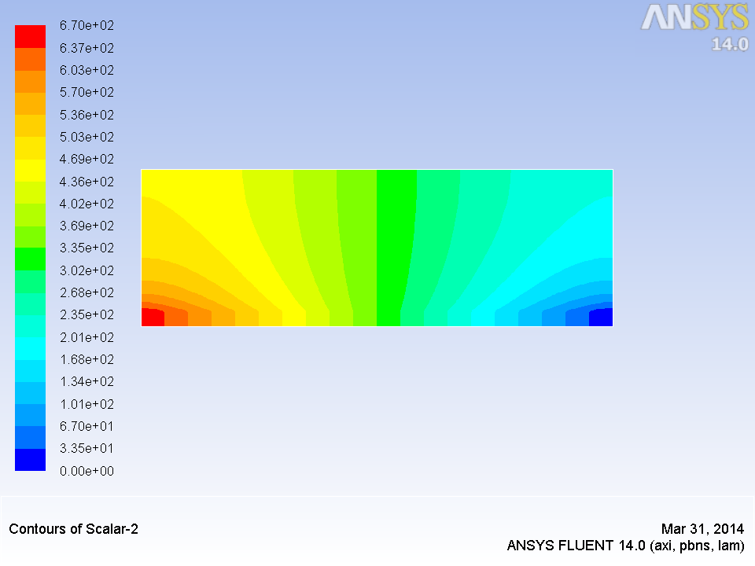
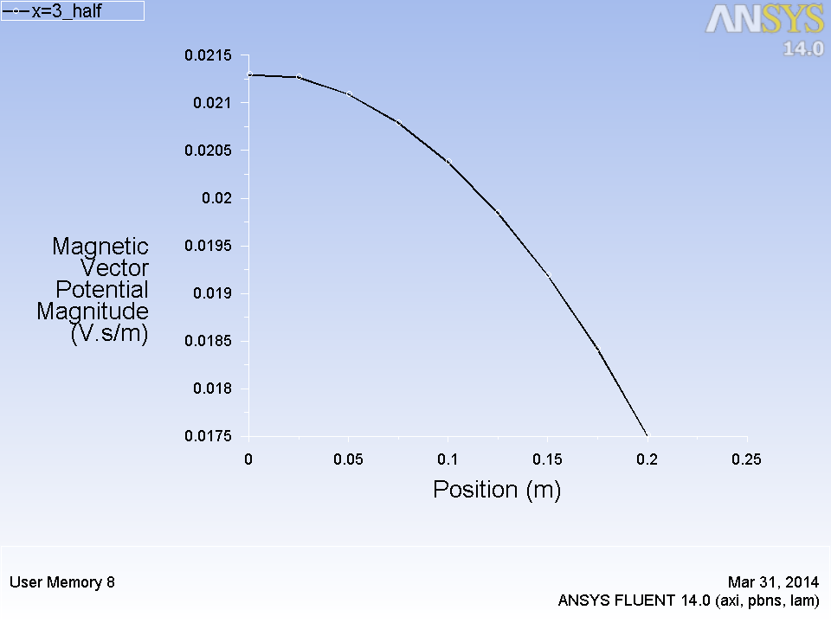
(a): Contour plot of magnetic field from FLUENT
(b): Contour plot of Electric potential from FLUENT
(c): Line plot of Magnetic Vector potential magnitude along radius of conductor
(a)
(b)
(c)

Slide 12
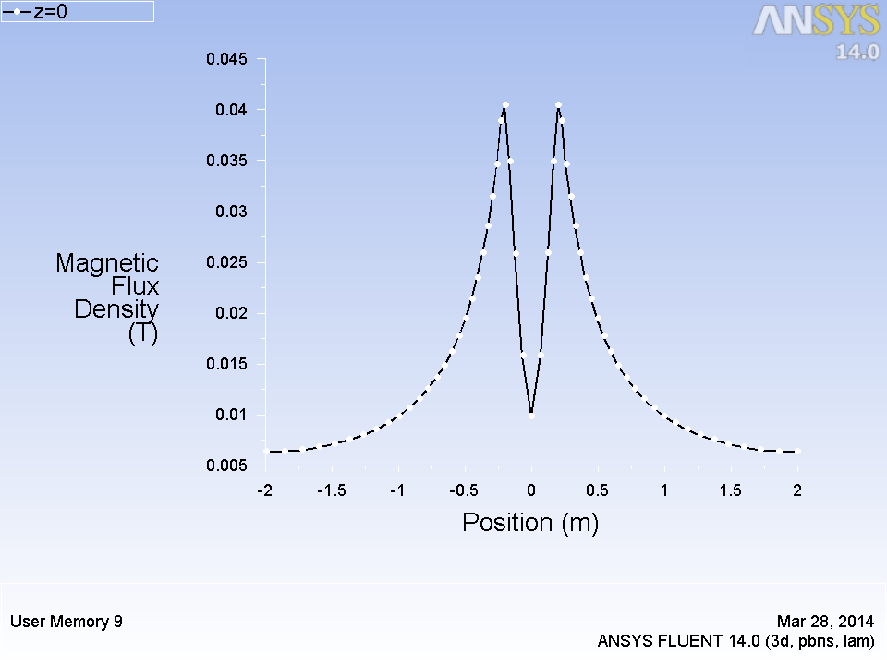
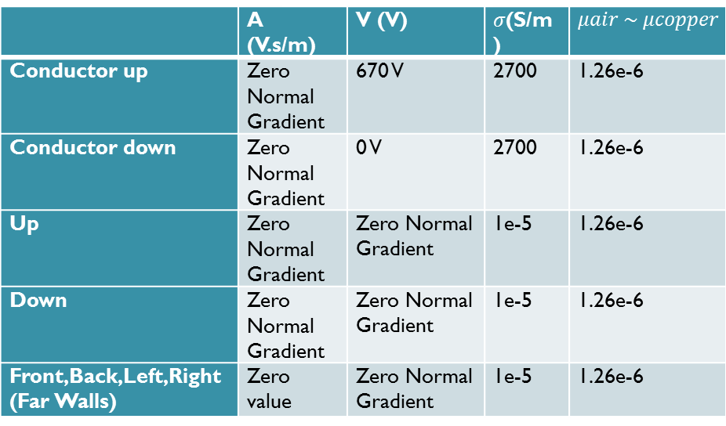
Validation 2 – Magnetic field around current carrying bar
Geometry of bar
Boundary Conditions
 | A (V.s/m) | V (V) | $σ$(S/m) | $$μair \sim μcopper$$
Conductor up | Zero Normal Gradient | 670 V | 2700 | 1.26e-6
Conductor down | Zero Normal Gradient | 0 V | 2700 | 1.26e-6
Up | Zero Normal Gradient | Zero Normal Gradient | 1e-5 | 1.26e-6
Down | Zero Normal Gradient | Zero Normal Gradient | 1e-5 | 1.26e-6
Front,Back,Left,Right (Far Walls) | Zero value | Zero Normal Gradient | 1e-5 | 1.26e-6
Line plot of magnetic field
along x at y=z=0

Slide 13
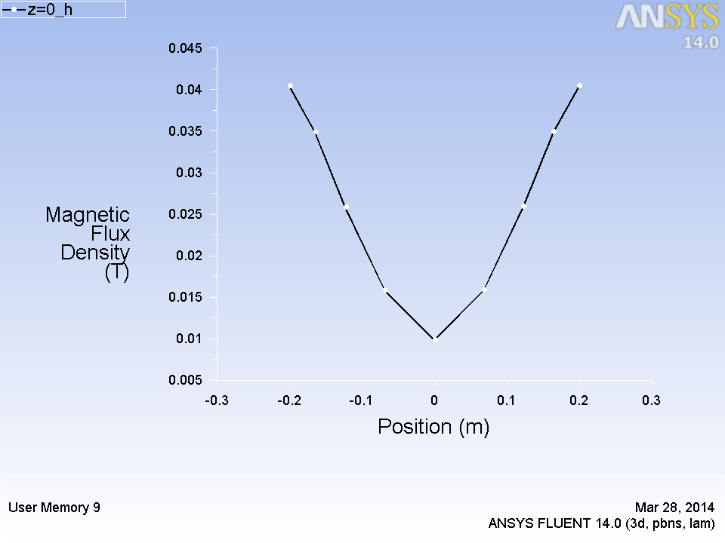
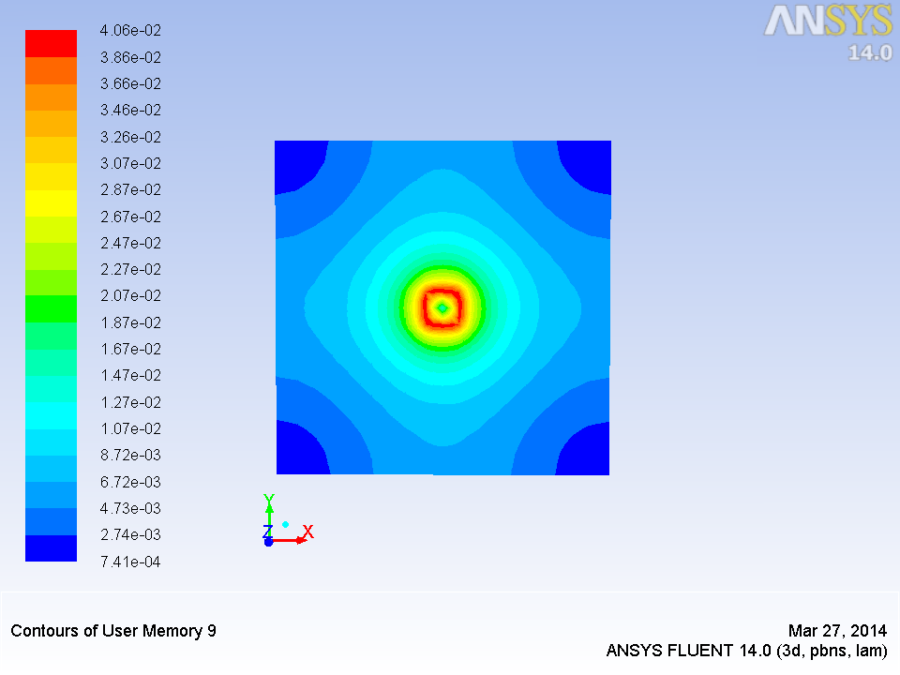
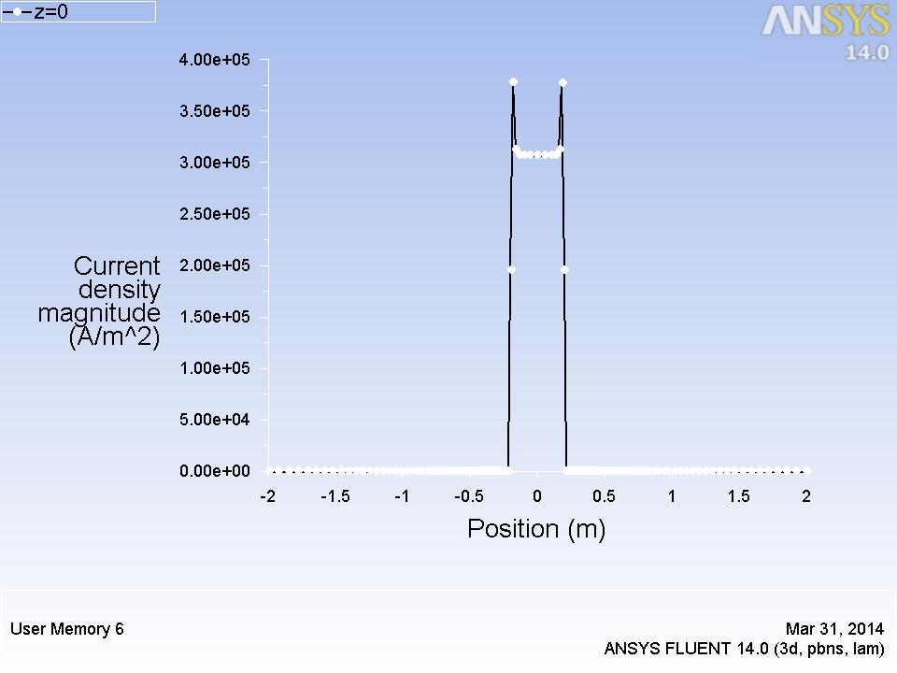
(a)
(a): Line plot of magnetic field inside the conductor
(b): Contour plot of Magnetic field from FLUENT
(c): Line plot of Current density magnitude along x at y=z=0
(b)
(c)

Slide 14
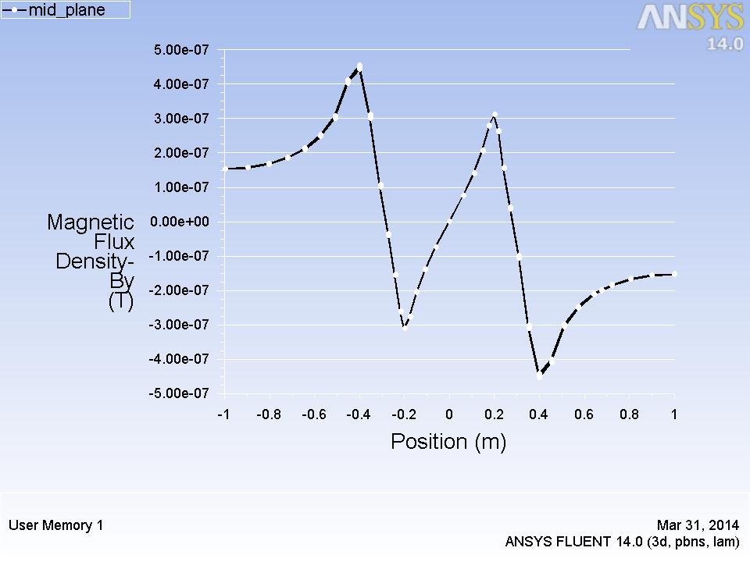
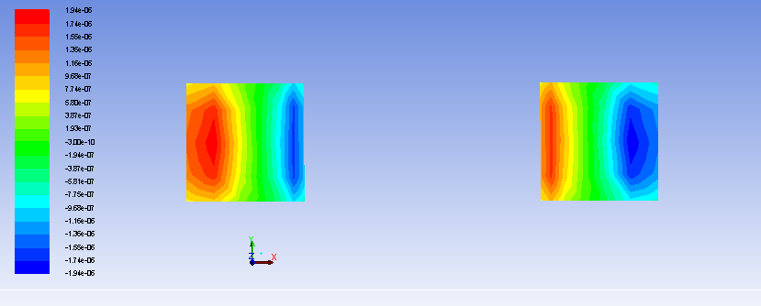
Validation 3 – Force between 2 parallel current carrying conductors
(a)
(a): Line plot of y component magnetic field
(b): Contour plot of x component of Lorentz force from FLUENT
(b)

Slide 15
Work to be done
Validation of code for magnetic field around a coil of single and multiple turns.
Simulation of magnetic field under influence of sinusoidally varying current/potential (AC)
Simulation of 3 phase displaced coils → Electromagnetic stirring

Slide 16
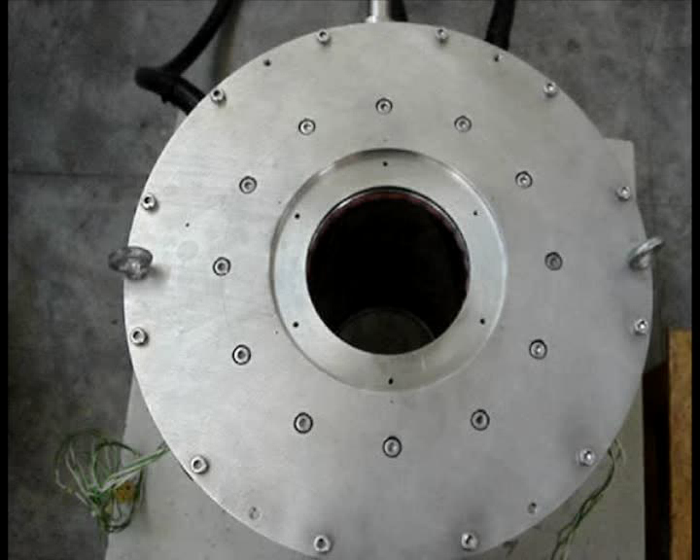

Slide 17
References
[1] Sass-Tisovskaya, Margarita. Plasma arc welding simulation with OpenFOAM. Chalmers University of Technology, 2009.
[2] Huang, Zhe. "OpenFOAM Simulation for Electromagnetic Problems." (2010).
[3] Westermoen, Andreas. "Modelling of dynamic arc behaviour in a plasma reactor." (2007).
[4] Fluent, A. N. S. Y. S. "12.1 User Manual." ANSYS Inc (2010).
[5]Milind, S., & Ramanarayanan, V. (2004, October). Design and analysis of a
linear type electromagnetic stirrer. In Industry Applications Conference, 2004.
39th IAS Annual Meeting. Conference Record of the 2004 IEEE (Vol. 1).
IEEE.

Slide 18
THANK YOU!

